Slide 1




The Future of Experience
Transforming Customer Journeys Through Immersive Design

Slide 2

Why Experience Matters
In a world where every click and interaction counts, experience has become the currency of loyalty.
Drives loyalty and lifetime value
Differentiates brands in saturated markets

Slide 3
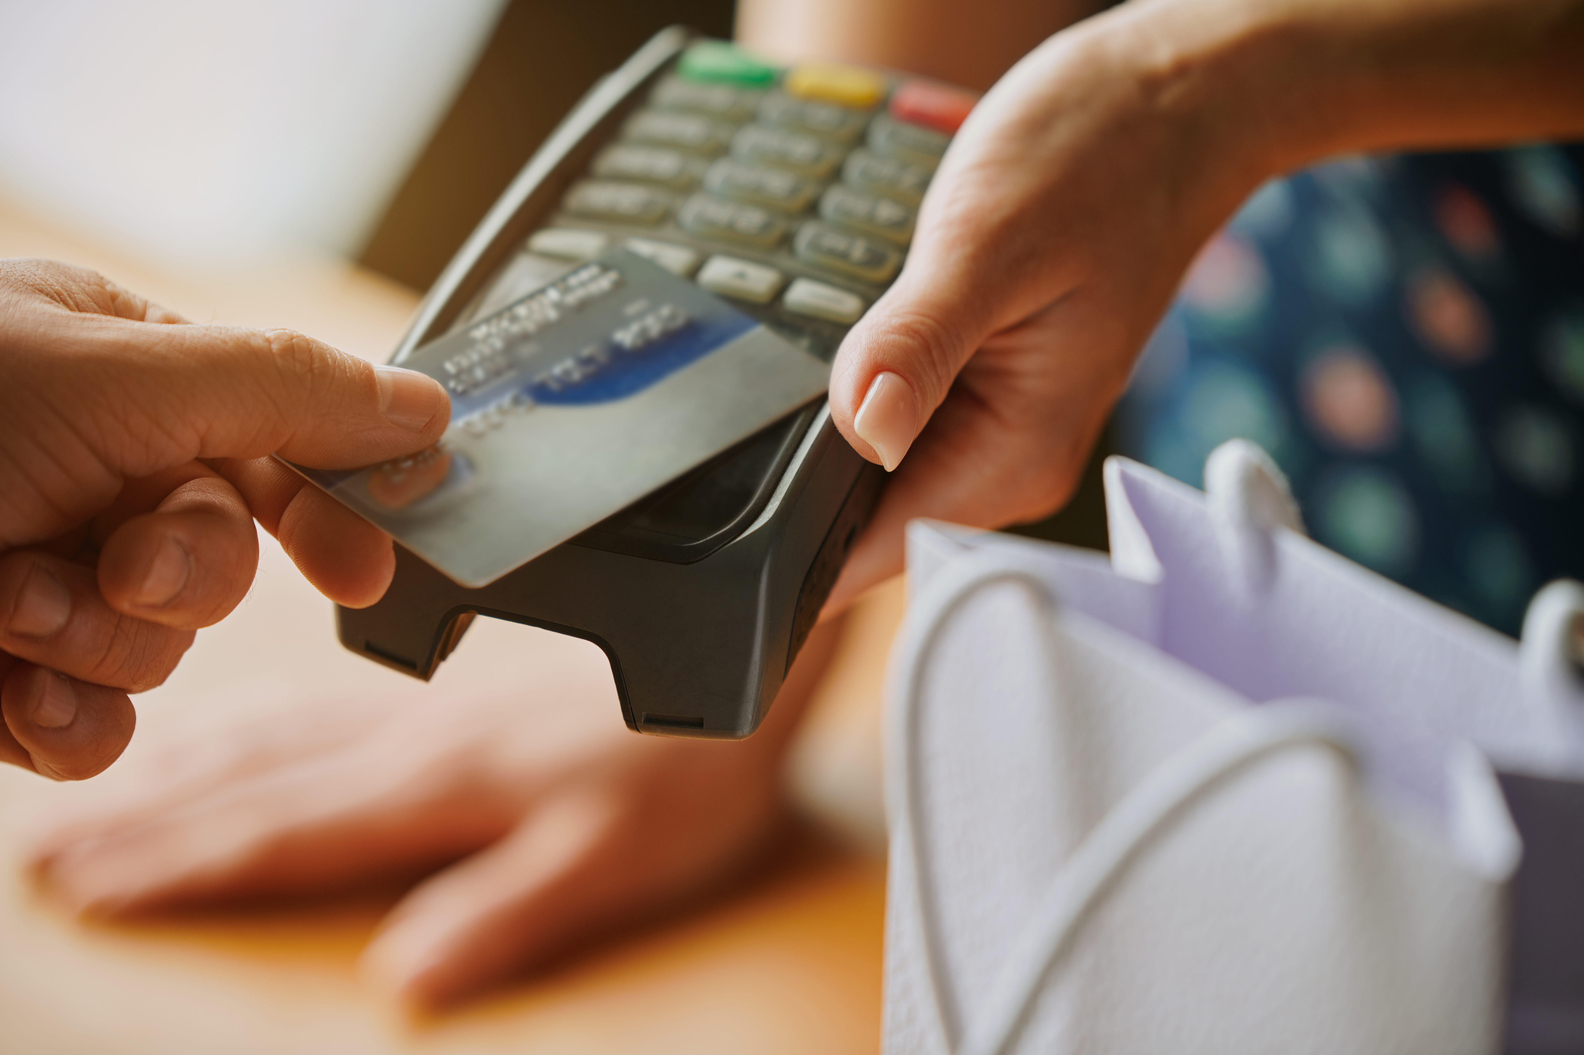
Experience Drives Loyalty & Lifetime Value
When customers feel emotionally connected through positive interactions, they return more often and spend more over time — even when competitors offer lower prices.

Slide 4

Travel Shapes Presentation
Experience Differentiates Brands in Saturated Markets
Products and services can be copied, but the way a company makes people feel becomes its most defensible competitive advantage.
Learn more

Slide 5

The Experience Gap
Despite investments in technology, most brands still struggle to connect emotionally.
Customer Expectation: 80% of customers believe the experience a company provides is as important as its products or services.
Brand Delivery: Only 50% of customers say companies actually deliver on those expectations.
👉 Experience Gap: ~30% difference between what customers expect and what brands deliver.
80%
50%
Customer Expectations
Brand Delivery

Slide 6

THANKYOU

